Slide 1
Enhancing Linear Programming with Attention Mechanisms
NaruPOL Hongthai

Slide 2
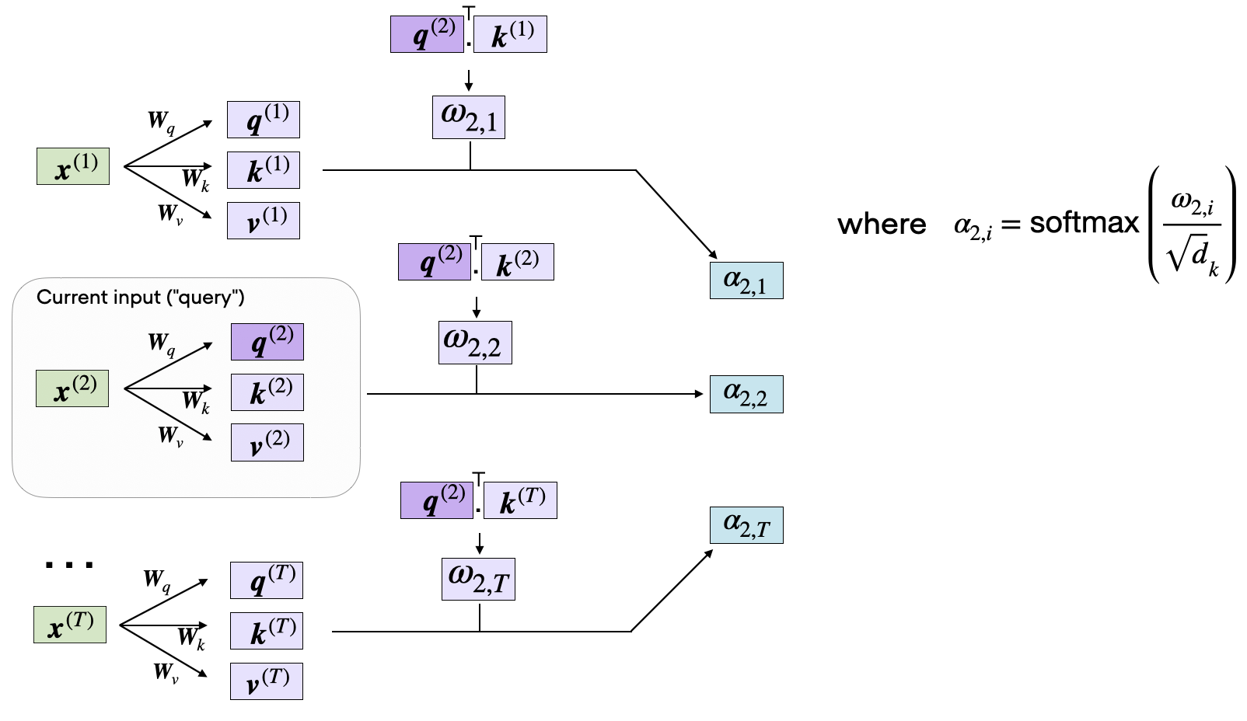
Introduction
Linear Programming (LP):
Linear programming is a method to achieve the best outcome (e.g., maximum profit, lowest cost) in a mathematical model whose requirements are represented by linear relationships.
Common applications include optimization in supply chain management, scheduling, resource allocation, and finance.
Role of Attention Mechanisms:
Attention mechanisms, widely used in machine learning, allow models to focus on specific parts of input data.
In the context of linear programming, attention can be used to selectively prioritize important constraints and variables, leading to faster and more efficient solutions.

Slide 3
Overview of Methods for Attention
Direct Approximate Solving with Attention: Solves LP problems by approximating solutions, using attention to focus on critical parts of the problem.
Primal-Dual Interior Point Method with Attention: Enhances the traditional interior point method by guiding the solution search process, reducing iteration cycles.
Column Generation with Attention: Applies attention to prioritize and efficiently generate columns (variables), making it suitable for large-scale LP problems.

Slide 4
Direct Approximate Solving with Attention
Concept:
This method involves directly approximating the solution to a linear programming problem by using attention mechanisms.
Instead of solving the entire problem exhaustively, the attention mechanism identifies and focuses on key variables and constraints that have the most impact on the final solution.
By prioritizing these elements, the method can deliver faster, near-optimal solutions.
Key Advantages:
Speed: Significantly reduces computation time by avoiding unnecessary calculations.
Efficiency: Focuses resources on solving the most influential parts of the problem, leading to quicker approximations.
Scalability: Capable of handling larger LP problems by selectively processing key data points.
Example Use Case:
Logistics & Routing: Optimizing delivery routes by approximating the shortest paths and prioritizing critical routes with higher demand, reducing overall computation time.

Slide 5
Primal-Dual Interior Point Method with Attention
Concept:
The Primal-Dual Interior Point Method is a popular approach for solving LP problems, where solutions are iteratively refined by simultaneously adjusting primal (original) and dual (constraint-based) variables.
Integrating attention mechanisms helps guide the search process by focusing on the most critical variables and constraints at each iteration.
This targeted focus allows the method to converge faster and more efficiently, reducing the number of iterations needed to reach an optimal solution.
Benefits:
Improved Convergence: Attention guides the algorithm towards optimal regions, accelerating the convergence process.
Reduced Iterations: By prioritizing key elements, the method requires fewer iteration cycles to find solutions, saving computational resources.
Enhanced Robustness: Better handling of complex and large-scale problems by selectively focusing on influential factors.

Slide 6
Column Generation with Attention
Concept:
Column Generation is a technique used to solve large-scale linear programming problems by generating variables (columns) only when needed, instead of solving with all variables upfront.
Attention mechanisms can be integrated to prioritize which columns (variables) to generate, focusing on those that have the highest potential to improve the solution.
This approach reduces the computational burden by dynamically focusing on the most promising variables, leading to a more efficient optimization process.
Key Benefits:
Efficient Handling of Large-Scale Problems: Able to solve LP problems with a vast number of variables by generating only a subset of necessary columns.
Scalability: Improved scalability through selective attention, making it suitable for problems with hundreds or thousands of variables.
Cost-Effective: Reduces unnecessary computations by focusing resources on high-impact variables.

Slide 7
END

